Slide 1
Welcome to the Solace and District Councils Network Workshop
Friday 18th November 2016
Eversheds, Leeds

Slide 2
Darren Walklate, Divisional Director of Solution and Service Design
Civica Limited UK

Slide 3
Welcome to Colchester’s Commercial Story
Adrian Pritchard, Chief Executive at Colchester Borough Council

Slide 4
The Colchester Story
Customer
Commercial
Community

Slide 5
The Colchester Story So Far
2008 – Fundamental Service Reviews
Planning, Protection and Licensing
Housing
Revenues and Benefits
Street Services
Colchester’s Housing and ALMO (CBH)
Sport and Leisure
New Housing Arrangements
Corporate and Financial Management
Customer Futures (remodelling Customer Services)

Slide 6
The Colchester Story So Far
Fundamental Service Reviews
Customer
Efficiency (target)
Effectiveness (performance)

Slide 7
The Colchester Story So Far
2008 – Fundamental Service Reviews
2010 – Fundamental Organisational Review
Journey Management
Behaviour Change
Commercial
Locations
Organisational shape
Cultural Change
Organisational governance
ICT
2010 – Flexible Working (agile)

Slide 8
The Colchester Story So Far
2008 Fundamental Service Reviews
2010 Fundamental Organisational Review
2010 Flexible (agile) working
2011 Savings targets
Commercial income targets
2012 Asset usage
2013 Trading Board established
Revolving Investment Fund (RIF)
Sub-Committee

Slide 9
The Colchester Story So Far
2014 Business / land acquisition
Council as developer
2015 Garden Settlements initiative
Housing company proposal
2016 Digital challenge
Smarter working
Paper chase
Customer self-serve
Internal self-serve

Slide 10
Financial Resources
 | Income in 2010 | Income in 2016
Central Government | 33% | 20%
Council Tax | 33% | 20%
Income Charges | 33% | 60%

Slide 11
How does the private sector become more Commercial?
Continually looking for efficiencies (driving costs down)
Increasing total revenue (driving up profit)
Increasing productivity (driving up pure profit)
Taking greater market share (spreading overheads wider)
Improve company image (building the brand to trade on)
Investing in Research and Development
(conveyor belt of future income lines)

Slide 12
The Entrepreneurial Council
Customer | Commercialism | Community
Avoidable contact | Flexible charging | Community development
Channel shift | Commercialise services | Community ownership
Customer journeys | Strategic procurement | Delegate functions
Transactional cost transfer | Asset usage | Transfer assets
Efficiencies | Borrowing investment | Voluntary organisations
Rationalisation | Developer role | Volunteering

Slide 13
The Digital Generation
Changing customer expectations
Constant delivery improvements
Transaction costs transfer
Customer utility
Changing customers expectations and behaviour

Slide 14
Changing customer behaviour – techniques
Hugs
Nudges
Shoves
Smacks
What do these look like?

Slide 15
Behavioural Change – Local Council Tax Scheme
Council Tax support scheme
Late Council Tax payers
Control Group
Send two page threatening legal letter
Intervention Group
Send simple text saying you owe money
Result
15% increase in payments from Intervention Group

Slide 16
Commercialisation Services
Which ones?
How?
For what?
Competitors?

Slide 17
Commercialisation Assets
Buildings
Land
Physical infrastructure
Intellectual property
Joint ventures
Wholly owned companies

Slide 18
Commercialisation Community
Days of action
Volunteers
Voluntary sector
Service delivery
Asset ownership

Slide 19
Culture
Conformity or
Answers
Here and now
Promotion for success
Identifying some dots
Training
Inquiry
Questions
Time and space
Reward for creativity
Connecting the dots
Learning

Slide 20
Organisational Goals

Slide 21
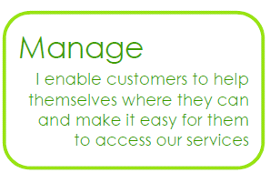
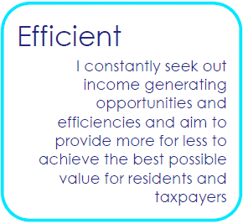
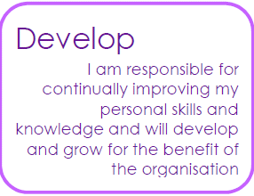
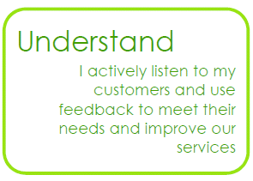
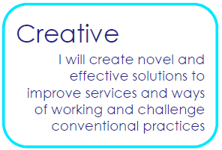
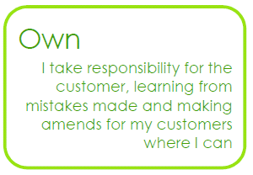
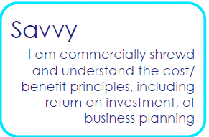
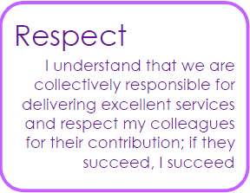
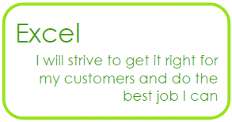
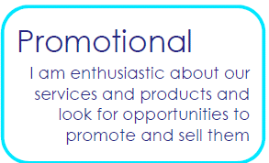
Underpinning attitudes and behaviours
Customer
Business
Culture

Slide 22
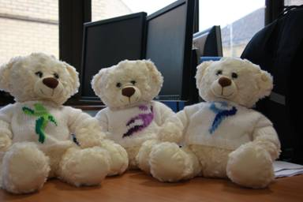
Customer bear - Miles
Business bear - Mercury
Culture bear - Bear-dicca

Slide 23
Corporate needs for commercialism to succeed
The narrative of need
Defining the operating model
Financial targets
Capture and evaluation of ideas
Political buy-in and engagement

Slide 24
Corporate challenges for commercialism to succeed
Appetite for risk
Full costs and recharges
Investment needed
Lead-in time
Rate of return
Skills and attitude

Slide 25
Remember…..
Reality is the enemy of the dream
The dream only occurs when grounded in reality

Slide 26
THE COMMERCIAL COUNCIL DR JUSTIN IVES CHIEF EXECUTIVE HAMBLETON DISTRICT COUNCIL

Slide 27
BACKGROUND

Slide 28
Unprecedented funding reductions since 2010
2011 Net Revenue Budget: £11m
2016 Net Revenue Budget: £ 7m
Government Grants 2011: £4.5m
Government Grants 2016: £1.5m

Slide 29
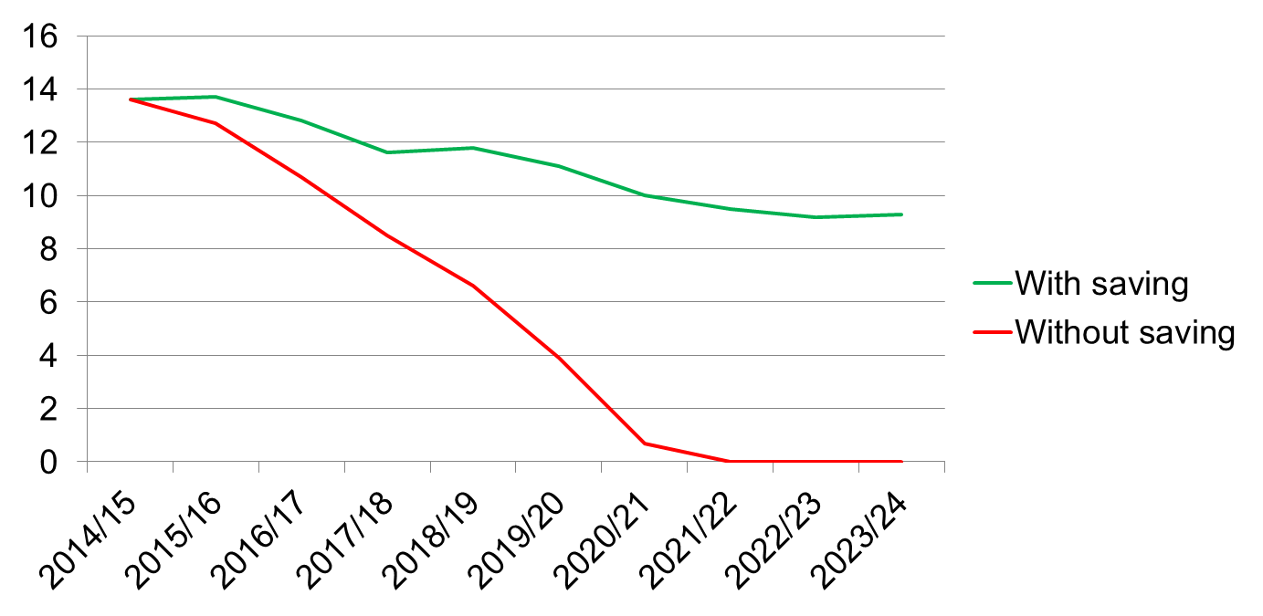
Total Reserve Levels

Slide 30
HOWEVER! NO SERVICE REDUCTIONS

Slide 31
HOW WAS THIS ACHIEVED?

Slide 32
Firstly using traditional cost reduction schemes:
Asset Transfer
Service Transfer
Shared Services

Slide 33
Effective to a point but the Council has an aspiration to increase and improve services.

Slide 34
THE COMMERCIAL COUNCIL
“Continually seeking income generation opportunities”

Slide 35
COMMERCIAL THINKING AT HAMBLETON DISTRICT COUNCIL
Loan to Housing Association
Local Asset Backed Vehicle
Fitness Suite
Green Waste
Economic Development Strategy

Slide 36
LOAN TO HOUSING ASSOCIATION
£35m loan for 25 years.
Generates £1.2m per annum in interest.
Housing initiative (Capital Expenditure)
NOT Treasury Management Activity.
Powers under Local Government Act 1988.
Obstacle
Members very resistant – Debt Free Council since 1992.
M.R.P.

Slide 37
LOCAL ASSET BACKED VEHICLE
HMP Northallerton closed in 2014.
Council purchased site to control development.
Currently in the process of procuring a partner.
Paid £1.3m for site.
Estimated dividend from LABV £2m.

Slide 38
FITNESS SUITE
Leisure income in decline.
Council needed to invest or extricate from the service.
3 Leisure Centres were refurbished.
1 Leisure Centre to be extended with a £2m Fitness Suite – to be open 24/7.
Increase in GP referrals plus a new anti-obesity initiative.
The aim is for Leisure to at least be self-financing.

Slide 39
GREEN WASTE CHARGES
Most Councils have investigated or are charging for this service.
Service will be self-financing - £0.8m per annum.
Strong political resistance.

Slide 40
ECONOMIC DEVELOPMENT STRATEGY
Born from Business Rate Retention.
Retain the growth we facilitate.
£5m investment.
Schemes include:
Northallerton Prison
Dalton Bridge
Northallerton BID
Market Town Studies

Slide 41
FUTURE OPPORTUNITIES
Selling services through a company.
Development Company.
Housing Company

Slide 42
QUESTIONS?

